Slide 1



Spring Cloud: Introduction to REST Audience: All

Slide 2
Introduction
Spring Cloud: Introduction to REST
Who I am: <Instructor Name>
Title
Organization
Role
Background

Slide 3
Agenda
Spring Cloud: Introduction to REST
Microservices – History, Driving Forces, and Definition
Microservices Patterns
DevOps
Reactive Microservices
1
5
9
13
AD
All
D
AD
A
Microservices Prerequisites
Integration
Securing Microservices
Testing
2
6
10
14
AD
AD
A
D
A
A
Spring Boot
Migrating Monoliths to Microservices
Domain Driven Design Testing
Scaling Microservices
3
7
11
15
AD
D
A
A
A
Case Study
Cloud
UI
Microservices Anti-Patterns
4
8
12
16
AD
AD
All
All
A
A
Legend: All Developer Advanced Developer Architect
All
D
AD
A

Slide 4

Objectives
Spring Cloud: Introduction to REST
At the end of this training, you should be able to:
Understand the REST architecture pattern

Slide 5
Topics
Spring Cloud: Introduction to REST
REST

Slide 6
REST

Slide 7
What is REST?
Spring Cloud: Introduction to REST
REST stands for Representational State Transfer.
It is an architectural pattern for developing web services as opposed to a specification.
REST web services communicate over the HTTP specification, using HTTP vocabulary:
Methods (GET, POST, and so on)
HTTP URI syntax (paths, parameters, and so on)
Media types (xml, json, html, plain text, and so on)
HTTP Response codes

Slide 8

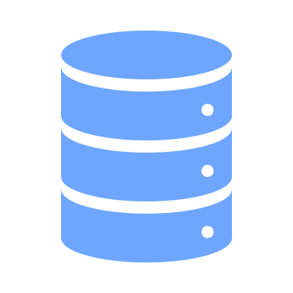
What is REST? (continued)
Spring Cloud: Introduction to REST
Representational
State Transfer
State of a resource is manifested through a specific representation
State of a resource is transferred between client and server
Resource is a very important concept in REST.
A resource is any information of importance in the context of given domain which has an identity, one or more attributes and some relationship with other resources.
In REST world a resource is represented using a URI.
A customer in a retail domain is a resource which can be represented by /customer URI.

Slide 9


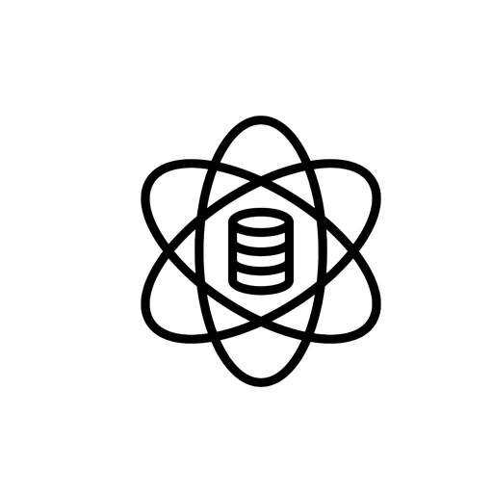



To be called ReSTFul a service must adhere to these six design constrains
Uniform Interface The uniform interface constraint defines the interface between clients and servers. It simplifies and decouples the architecture, which enables each part to evolve independently.
It also means that identification and representation of resources should be consistent across interactions.
Client Server The uniform interface separates clients from servers.
This means client and server need not worry about and design for each other’s concern.
Spring Cloud: Introduction to REST
Stateless Client and server may have multiple interaction. However, each of them must be independent, that is, every request must contain all the necessary information so that the server can understand and process it accordingly. Server is not required to hold any information pertaining to a request once it is served.
Cacheable Because many clients access the same server, and often requesting the same resources, it is necessary that these responses might be cached, avoiding unnecessary processing and significantly increasing performance.
Layered A client cannot ordinarily tell whether it is connected directly to the end server, or to an intermediary along the way. Intermediary servers may improve system scalability by enabling load-balancing and by providing shared caches. Layers may also enforce security policies.
Code-on-Demand This is an optional constraint of REST where Code-on-Demand means that a server can extend the functionality of a client on runtime, by sending code to it that it should execute (like Java Applets or JavaScript). This constraint is more useful when we think of applications themselves as resources.

Slide 10




The HTTP request is sent from the client to the server.
Spring Cloud: Introduction to REST
Identifies the location of a resource
Specifies the verb, or HTTP method to use when accessing the resource
Supplies optional request headers (name-value pairs) that provide additional information the server may need when processing the request
Supplies an optional request body that identifies additional data to be uploaded to the server (For example, form parameters, attachments, and so on)

Slide 11

The HTTP response is sent by the server to the client. A response must be initiated only when there is a request.
Spring Cloud: Introduction to REST
Gives the status of the processed request; HTTP Status codes have a fixed value and meaning – REST design should adhere to the meaning when mapping the response code to business meanings
Supplies response headers (name-value pairs) that provide additional information about the response
Supplies an optional response body that identifies additional data to be downloaded to the client (html, xml, binary data, and so on.)

Slide 12
HTTP Methods supported by REST
Spring Cloud: Introduction to REST
GET – Requests a resource at the request URL
POST – Submits information to the service for processing
Should not contain a request body, as it will be discarded
May be cached locally or on the server
May produce a resource, but should not modify on it
PUT – Add a new resource at the request URL
DELETE – Removes the resource at the request URL
OPTIONS – Indicates which methods are supported
HEAD – Returns meta information about the request URL

Slide 13
A typical HTTP REST URL
Spring Cloud: Introduction to REST
http://my.store.com/fruits/list?category=fruit&limit=20
protocol
host name
path to a resource
query string
The protocol identifies the transport scheme that will be used to process and respond to the request.
The host name identifies the server address of the resource.
The path and query string can be used to identify and customize the accessed resource.

Slide 14
In order to handle a REST request using a programming language like Java and framework like Spring REST, the framework must provide a mechanism to define controllers.
Spring Cloud: Introduction to REST
A REST service framework provides a controller for routing HTTP requests to a request handler based on four URL components.
The HTTP method used (For example, GET, POST)
Supplied path information
(For example, /service/listItems)
Query, form, and path parameters
Headers, cookies, and so on

Slide 15
Programming REST services in Java
Spring Cloud: Introduction to REST
Almost all popular language provide robust frameworks for developing REST services.
Please explore examples like Express in node.js and Django in Python.
Java defines REST support via the Java Specification Request (JSR) 311. This specification is called JAX-RS (The Java API for RESTful Web Services). JAX-RS uses annotations to define the REST relevance of Java classes.
JAX-RS
Jersey
Jersey is the reference implementation for the JSR 311 specification.
The Jersey implementation provides a library to implement Restful webservices in a Java servlet container or SpringBoot container.
Apart from being compliant with JAX-RS implementation, Jersey provides many extensions with additional features and utilities.

Slide 16
Like most modern Java specifications JAX-RS uses Annotations and Conventions to inject REST service behavior in code.
Spring Cloud: Introduction to REST
JAX-RS Annotations customize many parts of the REST service.
They identify the HTTP method for accessing a resource.
They identify the relative path for accessing a resource.
They identify how query and form parameters, headers, cookies, and other pieces of the HTTP request message map to Java parameters and fields.
They identify the available content types that can be consumed or produced for a resource.

Slide 17
JAX-RS HTTP Method Annotations
Spring Cloud: Introduction to REST
The following annotations bind a Java method to a HTTP method.
@GET @POST
@PUT @DELETE
@OPTIONS @HEAD
Only one HTTP annotation may be applied to a single Java method.
Multiple Java methods may be given the same HTTP method annotation, assuming that they are bound to different paths.

Slide 18
JAX-RS @Path Annotation
Spring Cloud: Introduction to REST
@Path annotations may be supplied to customize the request URI of resource.
@Path on a class defines the base relative path for all resources supplied by that class.
@Path on a Java class method defines the relative path for the resource bound to that method.
@Path on a method is relative to any @Path on the class.
In the absence of @Path on the class or method, the resource is defined to reside at the root of the service.
A leading forward slash (/) is unnecessary as the path is always relative.
The @Path annotation supports the use of template parameters in the form:
{ name : regex }
The template parameter name is required.
The colon (:) followed by a regular expression is optional and will default to the pattern:
[^/]+
Multiple template parameters may be defined in a single @Path.
Template parameter values will be injected into method parameters annotated with @PathParam.

Slide 19
Other commonly used JAX-RS Parameter Annotations
Spring Cloud: Introduction to REST
@QueryParam – maps to a query string parameter.
@FormParam – maps to a form POST parameter.
@PathParam – maps to a path segment.
@DefaultValue – supplies a default parameter value.

Slide 20
JAX-RS Annotations: Examples
Spring Cloud: Introduction to REST
@Path("example")
public class ExampleWebServiceRest {
@GET
public Item getInfo(@QueryParam(“infoId") Long id) {
// @QueryParam example
}
@POST
public Response editInfo(@FormParam(“infoId") Long id,
@FormParam("value") String value) {
// @FormParam example
}
@GET
@Path("{category}/{subcategory:[^/]*}")
public List<Info> getInfos(
@PathParam("category") String category) {
@PathParam("subcategory") String subcategory) {
// @Path and @PathParam example
}
}

Slide 21
JAX-RS Annotation for controlling Representation
Spring Cloud: Introduction to REST
@Produces
Used on a class or method to identify the content types that can be produced by that resource class or method
If not specified, CXF assumes any type (*/*) can be produced
CXF responds with HTTP status “406 Not Acceptable” if no appropriate method is found
@Consumes
Used on a class or method to identify the content types that can be accepted by that resource class or method
Method annotation overrides class annotation
If not specified, CXF assumes any type (*/*) is acceptable
CXF responds with HTTP status “406 Not Acceptable” if no appropriate method is found
Method annotation overrides class annotation

Slide 22
Examples of @Produces and @Consumes:
Spring Cloud: Introduction to REST
@Path("example")
public class ExampleRestService {
@POST
@Path(“infos")
@Produces({"application/json", "application/xml"})
@Consumes({"application/json", "application/xml"})
public List<Info> editInfos(List<Info> infos) {
// Does something and returns the modified list
}
}
The client submits JSON or XML content with the “Content-Type” header.
The client requests either JSON or XML content through use of the HTTP “Accept” request header.

Slide 23
When API go the REST Way

Slide 24
What is a REST API?
Spring Cloud: Introduction to REST
Application Programming Interface (API)
A set of functions and procedures allowing the creation of applications that access the features or data of an operating system, application, or other service – from the dictionary.
REST of RestFul API
A REST or RestFul API is an implementation of an API using principles of REST.

Slide 25
REST API: Best Practices

Slide 26
1. Define your API(s) using standards
Spring Cloud: Introduction to REST
API(s) are supposed to be consumed for building applications and it is very important that are well defined and follow a consistent interface styling.
Swagger is a set of tools which allows the API designers and programmers to define API(s) using OpenAPI specifications.
OpenAPI specification is designed to provide a language agnostic way of describing machine readable specifications of an API.
For more information on Swagger and OpenAPI, please visit https://swagger.io/.

Slide 27
2. Use Resource-oriented URL Design
Spring Cloud: Introduction to REST
1. HTTP methods to define verbs, URL(s) should only have nouns
GET /customers (read) ✓ POST /customers (create) ✓ PUT /customers (update) ✓ DELETE /customers (delete) ✓ GET /getCustomer ❌ GET /updateCustomer ❌
2. Primary key to identify a resource in path parameters
GET /customers/12345 ✓ PUT /customers/12345 ✓ GET /customers?id=12345 ❌
3. For any other attribute use filter
GET /customers?name=someone&type=permanent ✓ There is another popular mechanism to apply filters using RSQL. Search the resources on web to find out more
4. To traverse relations of a resource hierarchy extend the URL path
GET /customers/12345/orders ✓ GET /customers/12345/orders/123 ✓
GET /customers/12345/getOrders ❌
5. For procedural resource use verb in path
GET /policies/calculatePreminum ✓

Slide 28
3. Use HTTP codes to indicate status of a request
Spring Cloud: Introduction to REST
GET/customers/123
200 – OK, Indicated customer found and body contains information
404 – NOT FOUND, indicates there is no customer with id: 123
500 – INTERNAL SERVER ERROR, indicates a system error while getting resource; for example, database not available; With 500 an optional message can specify the nature of error and a body to contain additional information
POST/customers
201 – CREATED, Indicates customer created successfully with information passed in post body
406 – NOT ACCEPTABLE, Indicates invalid customer data in body and does not conform to schema
DELETE/customers/123
410 – GONE, Indicates customer deleted with id: 123
405 – NOT ALLOWED, Indicates clients are not allowed to delete customers

Slide 29





4. Other Design Practices
Spring Cloud: Introduction to REST
JSON is messy but beautiful – Use It
Version your API(s) carefully
JSON is easy to read, has efficient tag to data content ration, easy to extend, widely supported in most programming languages. Prefer is over XML.
Build API(s) with versioning support to help seamless upgrades, have a very well-defined strategy for creating new versions and retiring old versions of API, avoid using headers for versioning, the version should be reflected in URL for clarity
GET http://www.myorg.com/crm/v1/customers/123/orders/11
Design for Caching
Allow Field Limiting
One of the core strengths of HTTP is to allow underlying infrastructure like webservers and proxies to cache the content. Design your API(s) in a way that complements the caching architecture to take full advantage of performance tuning measures.
Real life resources can be large. For example a real-life customer may have as many as 400-600 attributes. What if the API consumer only needs to retrieve city where he lives? A well designed API should provide methods to traverse the resource relations and limit the amount of information retrieve in each call.
There are several ways it can be achieved. A comma separates list of fields is one of the most common way, for example, to retrieve a customer mailing address’s city and zip:
GET- http://www/myorg.com/crm/v1/customers/123/addresses?type=mail&fields=city,zipcode

Slide 30
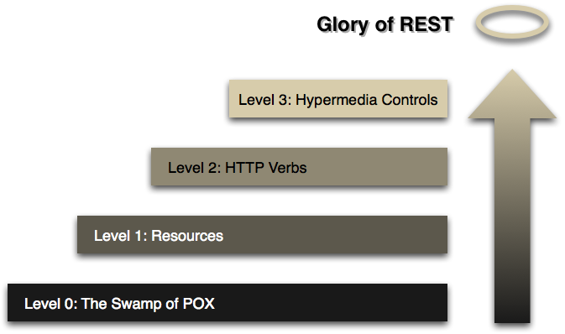
REST Maturity Model
Spring Cloud: Introduction to REST
Developed by Leonard Richardson
Level 0:
The starting point for the model is using HTTP as a transport system for remote interactions, but without using any of the mechanisms of the web.
Level 1:
The first step towards the Glory of Rest in the RMM is to introduce resources. So now rather than making all our requests to a singular service endpoint, we now start talking to individual resources.
Level 2:
Using the HTTP verbs as closely as possible to how they are used in HTTP itself.
Level 3:
HATEOAS (Hypertext As The Engine Of Application State).

Slide 31

Q&A

Slide 32

Summary
Spring Cloud: Introduction to REST
Summary
In this course, you learned about the following:
The REST architecture pattern

